Slide 1
Welcome!
Notes:
SYMBOL OF PHARMACY, MORTAR AND PESTLE

Slide 2
INTRODUCTION
Sakina Sawhney, Pharm.D.
sakinasawhney@gmail.com
University of the Pacific, Alumni
Practice Setting:
Hospital Pharmacist at Sutter Health, Castro Valley, California.

Slide 3
History of Pharmacy
Has been around since the beginning of time
Plants used as medicine (to this day)
First pharmacies established in India as Ayurvedic medicine
Ancient Egyptian pharmacopeia on papyrus
Ancient Greece had groups of individuals who were experts in pharmaceuticals during the Golden Islamic Age
Japan had men who were pharmacists in their time and they were highly regarded and respected by the Imperial Palace during the year 700’s
Ancient Chinese pharmacy manuals compiled in Han Dynasty from year 1 AD found in tombs. These had detailed descriptions of ailments and their treatments.
Always has been a respectable profession since ancient times

Slide 4
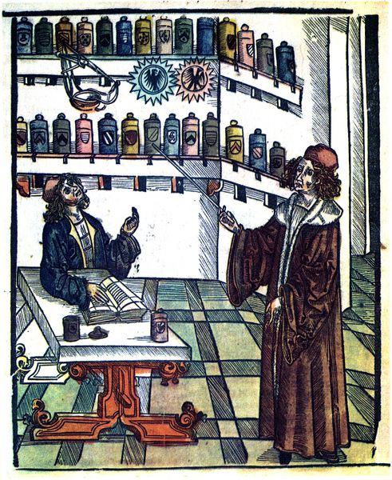
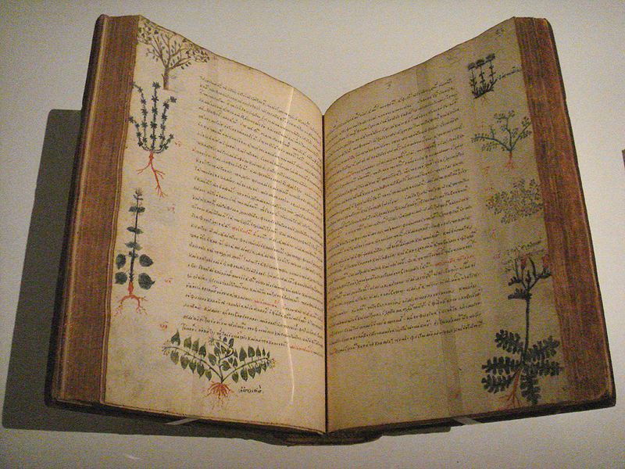
Ancient pharmacopeia
http://en.wikipedia.org/wiki/History_of_pharmacy

Slide 5
Pharmacy – One of the most noble professions
Pharmacists are amongst the most trusted professionals (2)
Notes:
Place 2nd only after nurses were included in the gallup poll, until then they have been always placed as number 1 of the most trusted professional. The survey included 22 professions. Last were car salesmen ☺ and members of Congress!!!

Slide 6
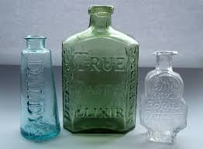
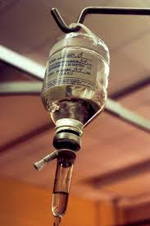
DEFINITION OF A PHARMACIST
phar·ma·cist
noun \ˈfär-mə-sist\
: a person whose job is to prepare and sell the drugs and medicines that a doctor prescribes for patients
SYNONYMS: APOTHECARY, DRUGGIST, CHEMIST (BRITAIN)

Slide 7
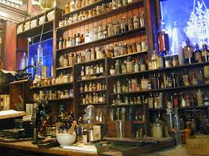
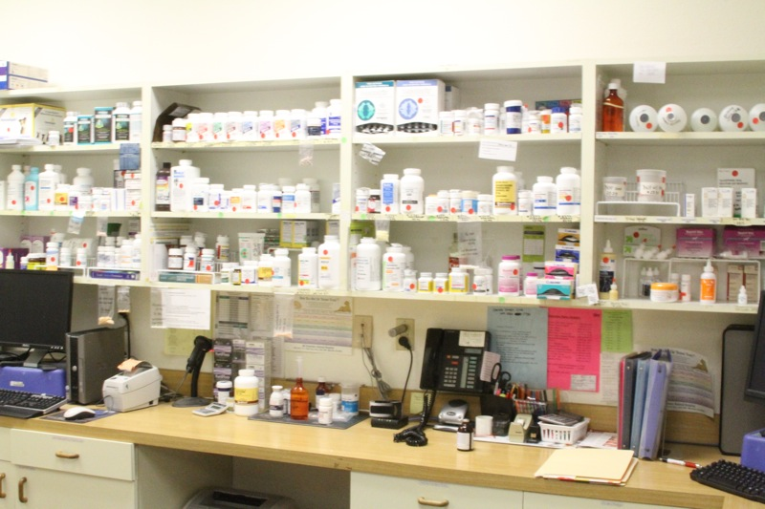
Past
Present

Slide 8
Pharmacists plays an essential role as part of the healthcare team
Drug delivery and medication safety
Patient education and support
Monitoring drug therapy
Teaming with other health care providers
Research and clinical studies

Slide 9
Ethics, regulations and standards of pharmacy
Every phase of Pharmacy practice is regulated by the State Board of Pharmacy
Licensing
Testing
Manufacturing
Dispensing
Advertising
Protecting the public is the primary goal of the State board of Pharmacy
Each state has their own Board of Pharmacy
Notes:
Pharmacy is one of the most regulated professions in the country and one of the most ethically challenging. State boards of pharmacy regulate,
administer and inﬂuence every phase of pharmacy practice, including the
requirements and testing to become a licensed pharmacist. Each state board
is made up of pharmacists who come from every practice area — hospitals,
chains, independent pharmacies

Slide 10
REQUIREMENTS TO PRACTICE AS A PHARMACIST
PHARM.D.
(Doctor of Pharmacy)
Licensed by State Board of Pharmacy

Slide 11
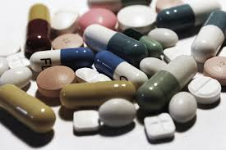
Areas of Pharmacy Practice Different types of pharmacists

Slide 12
ACADEMIC PHARMACIST
What do you need?
Ability to balance research and teaching responsibilities with patient care
Ability to serve as a role model for pharmacy students and residents
Comfort with sophisticated instrumentation, statistical analyses, and other research methods
Where will you practice?
Universities
Schools of pharmacy
Local, state, national, and international organizations
Notes:
There are many areas of Pharmacy Practice

Slide 13
COMMUNITY PHARMACIST
Walgreens CVS Rite-Aid
Safeway Pharmacy Store based Field Based Office based What do you need? • Endurance to work long hours, often standing up • Ability to handle multiple tasks and heavy workloads • Ability to endure high levels of stress • A desire to help people and improve the quality of their lives • A strong ability to communicate clearly and effectively • A team approach and a positive attitude
Where will you practice? • Traditional chain drugstores • Supermarket pharmacies • Mass merchandiser pharmacies

Slide 14
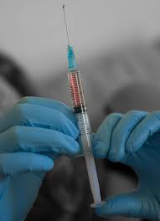
HOSPITAL PHARMACIST
Critical Care
Drug Information
Operating Room
Infectious Disease
Nuclear pharmacy
Staffing
Satellite operations
IV Room
Chemotherapy
Ambulatory Care
Monitoring
Clinical Expertise
Management
Nutrition Support
HOSPICE
Notes:
Some of these areas can be a specialty in itself. For example nuclear pharmacy

Slide 15
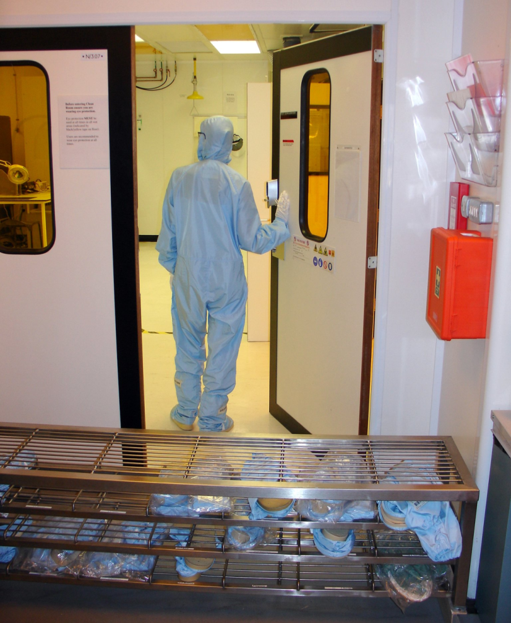
CONT’D
What do you need? • Ability to work one-on-one with patients • Organizational skills, to be responsible for systems which control drug distribution • Proﬁcient in math • Good communication skills
Where will you practice? Hospitals Health systems]
Universities
Government
Research Settings
Outpatient Clinics
Infusion Centers

Slide 16
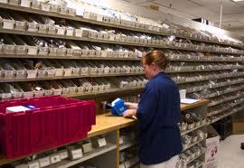

Slide 17
MANAGED CARE PHARMACIST
What do you need? • Ability to perform research and analyze results • Willingness to work closely with physicians, case managers, and other care givers • Business and management skills • Ability to interact with clients and solve their problems
Where will you practice? • Health Maintenance Organizations • Preferred Provider Organizations • Care management programs

Slide 18
NUCLEAR PHARMACIST
What do you need? • Ability to serve as a Radiation Safety Ofﬁcer (training is needed in areas such as radiation physics, biology and radiopharmaceutical chemistry, followed by one year of experience as a radiation safety technologist) • Training in the handling of radioactive materials (can be obtained as part of PharmD or through company training) • Ability to describe literature regarding radiopharmaceuticals to hospital and lab staff • Designation as an “authorized user” of radioactive materials (issued by NRC or the state radiological division) • One-year residency in nuclear pharmacy is preferred • Board specialty in nuclear pharmacy is preferred
Where will you practice? • Specialized pharmacies • Imaging centers • Hospitals • Universities

Slide 19
HOME HEALTH CARE PHARMACIST
What do you need? • Willingness to work as part of a multidisciplinary health care team • Effective communication skills • Strong record-keeping and documentation skills • Willingness to be ﬂexible with hours and on-call • Intravenous experience preferred
Where will you practice? • Patients’ homes • Home care agencies • Hospices • Specialized infusion companies • Ambulatory infusion centers

Slide 20
HOSPICE PHARMACIST
What do you need? • Compassion in counseling and educating hospice patients and their families • Ability to work with a team of nurses, physicians, social workers, bereavement counselors, and volunteers • Ability to give clear, precise directions and explanations to elderly patients • Clear concept of appropriate pain management techniques and palliative care medicine • Residency in Hospice may be preferred (especially for a practitioner without advanced degree training)
Where will you practice? • Hospices • Pharmacies under contract with hospices • Patients’ homes

Slide 21
POISON CONTROL PHARMACIST
Poison control Pharmacist • Certiﬁcation by the American Association of Poison Control Centers may be required within the ﬁrst two years • Course work in clinical toxicology is preferred • One-year residency in poison-control Pharmacy is preferred
Where will you practice? • Poison control centers • Hospitals • Universities • Consulting ﬁrms

Slide 22
COMPOUNDING PHARMACIST
What do you need? • Advanced training in advanced compounding techniques • Creativity and problem-solving skills • Ability to work one-on-one with patients and determine individual needs • Three-day course to teach special compounding skills
Where will you practice? • Compounding pharmacies • General pharmacies • Hospitals • Universities

Slide 23
LONG TERM CARE PHARMACIST
What do you need? • Good communication skills and ability to interact well with people • Ability to work as part of a healthcare team • Must enjoy working with a geriatric community • Certiﬁcation in geriatric pharmacy is preferred • One-year residency in geriatric pharmacy is preferred • Clerkships in long-term care may be helpful
Where will you practice? • Nursing homes • Hospitals • Assisted-living facilities • Psychiatric hospitals • Home care • Sub acute care facilities

Slide 24
MILITARY PHARMACIST
What do you need? • Ability to handle a lot of responsibility early in your career • Desire for foreign travel and frequent moves • Desire to work in and out of a hospital setting • U.S. citizenship
And… a satisfactory physical exam!
Where will you practice? • Army pharmacies • Navy pharmacies • Air Force pharmacies • Public Health Service pharmacies

Slide 25
ONCOLOGY PHARMACIST
What do you need? • Board certiﬁcation as an oncology pharmacist • Caution and sensitivity to work in an arena where experimental drug therapies are frequently used • Ability to recognize the balance between improved survival and quality of life • One-year residency may be required • Board certiﬁcation in oncology pharmacy is preferred • Hospital pharmacy experience, preferably in a critical care setting
Where will you practice? • Hospitals • Universities • Cancer centers

Slide 26
PEDIATRIC PHARMACIST
What do you need? • Desire to work with children • Strong oral and written communications skills • Strong investigative, research, and problem- solving skills • One-year general residency followed by a specialty residency in pediatric pharmacy may be required
Where will you practice? • Children’s hospitals • Hospitals • Universities • Cancer centers

Slide 27
PSYCHIATRIC PHARMACIST
What do you need? • Ability to work as part of a multidisciplinary team • A broad knowledge of psychiatric disorders and treatments • A interest in interacting with psychiatric patients • One-year residency in psychiatric pharmacy is preferred • Certiﬁcation as a Board Certiﬁed Psychiatric Pharmacist (BCPP) is preferred
Where will you practice? • Psychiatric hospitals • Hospitals • Universities • Home health care • Nursing home care • Acute care facilities • Ambulatory care facilities

Slide 28
VETERNARY PHARMACIST
• Creativity and resourcefulness for dealing with a variety of animal patients and their owners • Ability to work closely with veterinarians • Strong knowledge base in pharmacy and the willingness to compound prescriptions • Ability to solve problems, prepare products, teach and consult with healthcare workers and pet owners • Background in animal husbandry may be preferred • Membership in the Society of Veterinary Hospital Pharmacists (SVHP) or American College of Veterinary Pharmacists (AVCP), and/or special training or certiﬁcation by them may be preferred
Where will you practice? • Specialized veterinary pharmacies • Veterinary schools • Animal clinics • Animal hospitals • Rescue centers • Universities • Compounding pharmacies • Chain pharmacies

Slide 29
INDUSTRY BASED PHARMACIST
What do you need? • Ability to meet technical demands and perform scientiﬁc duties • Administrative, management, and/or business skills may be useful • Sales and/or marketing skills may be useful • Excellent communication skills • Experience in the discipline of interest • Exceptional credentials for those interested in the research area
Where will you practice? • Pharmaceutical companies • Biotechnology companies

Slide 30
REGULATORY PHARMACIST
What do you need? • Project management/organizational skills • Negotiation and communication skills • Understanding of the scientiﬁc and technical background of products • Willingness to keep up to date with regulatory policies and procedures
Where will you practice? • Associations • Government • Consulting companies • Pharmaceutical companies • Universities

Slide 31
PHARMACISTS IN NON-TRADITIONAL SETTINGS
Information Technology Pharmacists
Expert programmers and managers of EPIC, EHR, etc…
The Pharmacist Attorney The Pharmacist in Financial Industry The Ofﬁce Based Pharmacist The Pharmacist in an Advertising Agency

Slide 32
LIST OF PHARMACY SCHOOLS IN CALIFORNIA
California Health Sciences University - School of Pharmacy, Clovis, California
California Northstate University College of Pharmacy - Sacramento, CA
Loma Linda University - School of Pharmacy, Loma Linda, California
Skaggs School of Pharmacy & Pharmaceutical Science - University of California, San Diego
Touro University California - College of Pharmacy, Vallejo, California
University of California, San Francisco - School of Pharmacy, San Francisco, California
University of the Pacific - Thomas J. Long School of Pharmacy & Health Science, Stockton, California
University of Southern California - School of Pharmacy, Los Angeles, California
West Coast University (to launch Los Angeles Campus in 2013) - College of Pharmacy
Western University of Health Sciences - College of Pharmacy in Pomona, Callifornia

Slide 33
HOW MUCH DOES A PHARMACIST EARN?
Remember…this is just an average
Some expert in their fields earn much more
for example, Consultants and EPIC pharmacists

Slide 34
FUTURE PROSPECTS IN PHARMACY
Outlook
The BLS (Bureau of Labor Statistics) expects employment for pharmacists as a whole to grow by as much as 25 percent through 2020. This is nearly twice the national average for all U.S. occupations, an estimated growth of 14 percent. Being a relatively large field, the 25 percent growth should work out to the creation of almost 70,000 new jobs over the course of a decade. However, job prospects will likely be better for clinical pharmacists as many clinics, nursing homes and outpatient care centers are in need of qualified candidates.

Slide 35
TO FIND OUT MORE…
https://www.google.com/search?q=pfizer+pharmacy+career+guide&oq=pfizer+pharmacy+&aqs=chrome.2.69i57j0l5.7667j0j8&sourceid=chrome&es_sm=93&ie=UTF-8
http://www.pharmacist.com/career-option-profiles
http://careerplanning.about.com/od/occupations/p/pharmacist.htm
http://www.kaiserpermanentejobs.org/videos/Pharmacy
http://explorehealthcareers.org/en/Career/14/Pharmacist

Slide 36
Thank-you All the best for your future

