Slide 1
Senior College Seminar
Mrs. Wright
College and Career Advisor

Slide 2
Overview
Wk of 8/19 Overview: transcripts and testing, college rep visits, visiting colleges
Wk of 8/26 Building your college list and spreadsheet, Naviance, letter of rec requests
Wk of 9/2 Application timelines, types of applications, UC, CSU, private and out-of-state
Wk of 9/9 College Essays, LOR Requests
Wk of 9/16 UC App Intro
Wk of 9/23 Common app
Wk of 9/30 Coalition App, UC and CSU applications
Wk of 10/7 Supplemental Essays, turn in essays and receive feedback
Wk of 10/14 Test scores, letter request, FAFSA and CSS profile
Wk of 10/21 CSU apps
Wk of 10/28 Individual work, final essays, work on applications
Wk of 11/4 Application follow up, financial aid/scholarships
Wk of 11/11 Individual check in. Set up portals, checking for follow up documents
Wk of 11/18 Finalizing CSU and UC applications
Wk of 12/2 How to request midyear transcripts, email updates
Wk of 12/9 Financial aid and scholarship apps

Slide 3
Where Should I be in the Application Process?
The short answer? Exactly where you are!
Look at College Rep Visits
Schedule to Visit Campuses
Gather information about Who You Are.

Slide 4
College Rep Visits
Over 100 College Admissions Reps will visit between next Monday and November 30!
You will be able to meet directly with the person who will read your application.
Do your research
Ask smart questions
Establish a relationship

Slide 5
How do I sign up?
Naviance
Look in Section called “What’s New.”
Click on the college visit you’re interested in attending.
Click on the registration button.
Print out registration.
Show it to your teacher and get their signature on it.
Bring it to your college visit.
Sign in to college visit.
Hand your registration to Mrs. Wright.

Slide 6
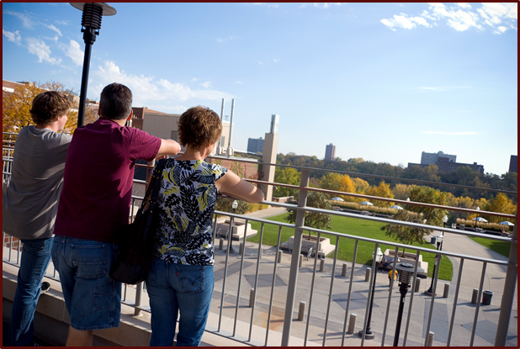
College Campus Visits
Why?
Different perspectives. You can only get so much from a website & brochure.
New life experience
To test your interest
To “see” yourself there
Who?
Students, parents, and siblings
Where?
Know yourself first
A variety of school types…large/small, public/private, single gender/co-ed, specialty (religious, military, art)
Different locations… urban/rural, in state, out of state, transportation, weather, etc…

Slide 7
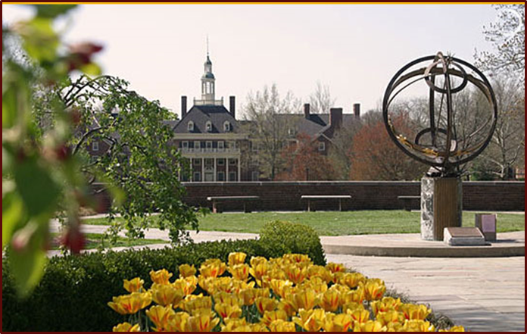
Best Time to Visit a College Campus
Visit before you apply, after you apply or after you’ve been admitted!
Monday – Thursday
During the academic school year. Avoid when school is not in session
Campus tour, open house, or information session,
Admissions interview

Slide 8
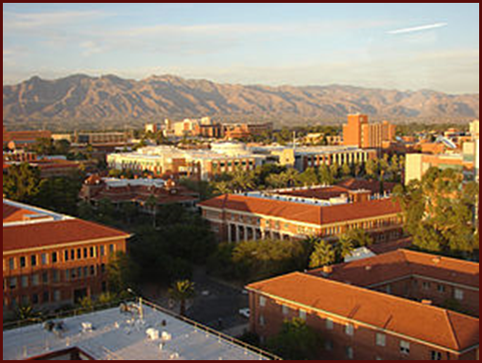
Preparing for Your College Visit
Plan Ahead! Give the college as much notice as possible
Call Admission offices
Confirm your visit
Dress appropriately
Print off a map of campus
Find out where to park
Ask for a hotel recommendation
Check out the website & do some research
Establish a list of questions you would like answered
Contact students you may know at the college

Slide 9
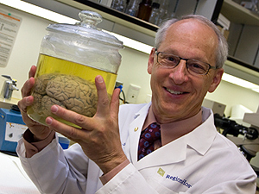
Making the Most of Your Visit
Spend the entire day on campus
Go on a tour of campus
Check out a residence hall & dining hall
Meet with a faculty member from intended major
Talk with current students
Eat a meal on campus
Attend a class
Interview or meeting with an admissions officer
Utilize student transportation
Talk to local community about school

Slide 10
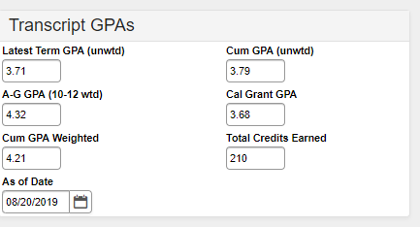
Check-In on You
Check your transcripts
Check Accuracy
Know Your GPA’s
Check your SAT/ACT Test Scores
Do I need to take both?
Do I need to re-test?
Check your Blue Book
Letters of Recommendation
Check email address
College list
Activities list

Slide 11
More Questions? Sign up to Meet with Your College Advisor – Me!
Sign up sheet in the College and Career Center
Test prep books, college brochures,
Scholarship & job info
Laptops for research
Questions you can’t ask in front of the group.
Thanks for Coming and See you Next Week!

