Slide 1
The UC APPlication
Senior Seminar Week 5

Slide 2
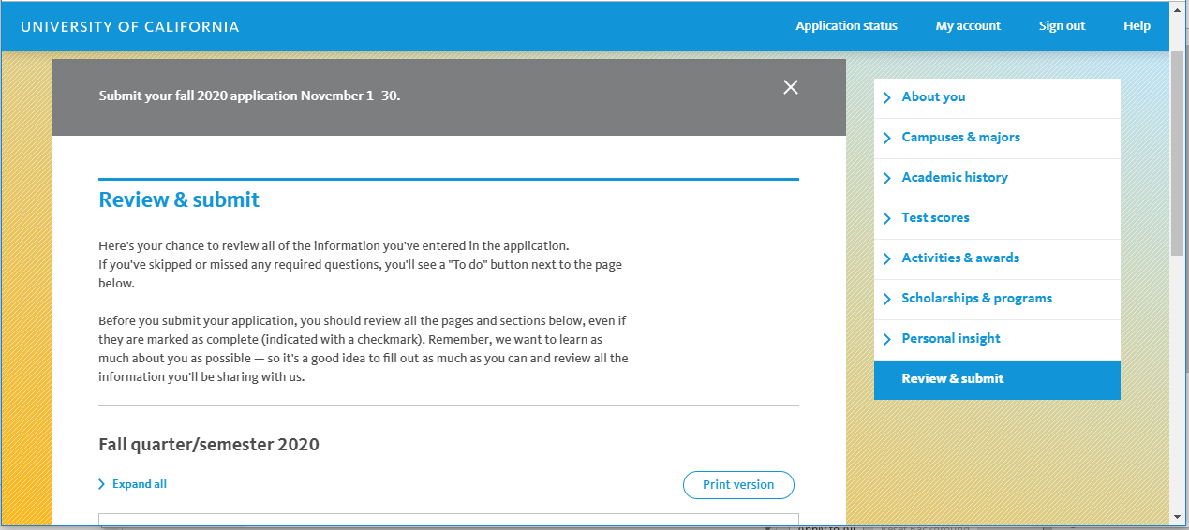
The New Face of the uc app!

Slide 3
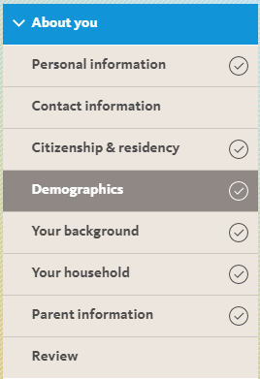
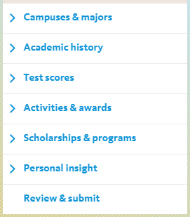
All about you!
Part 1:
Part 2:

Slide 4
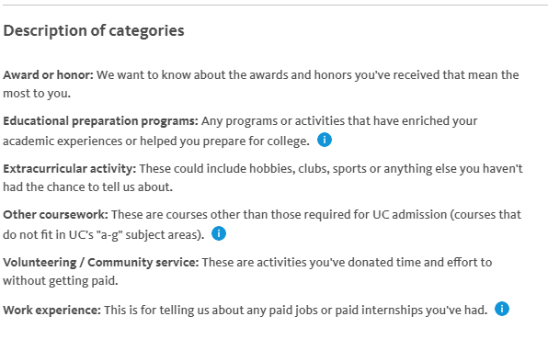
Activities

Slide 5
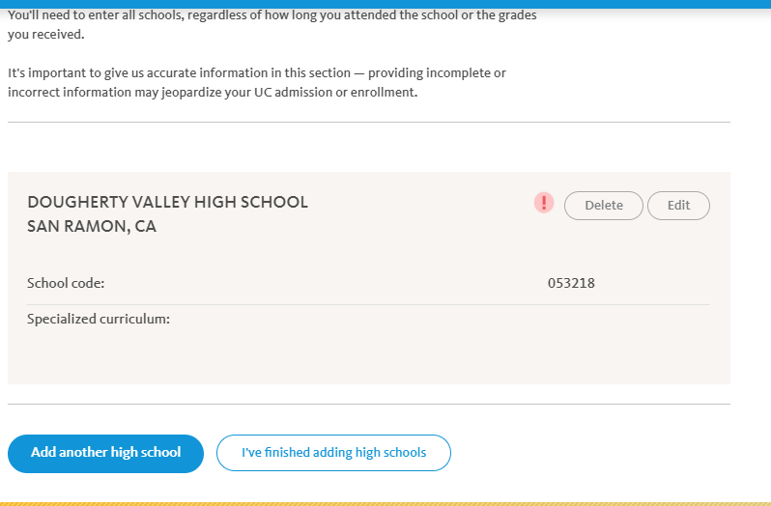
Is Dv the only hs you attended?

Slide 6
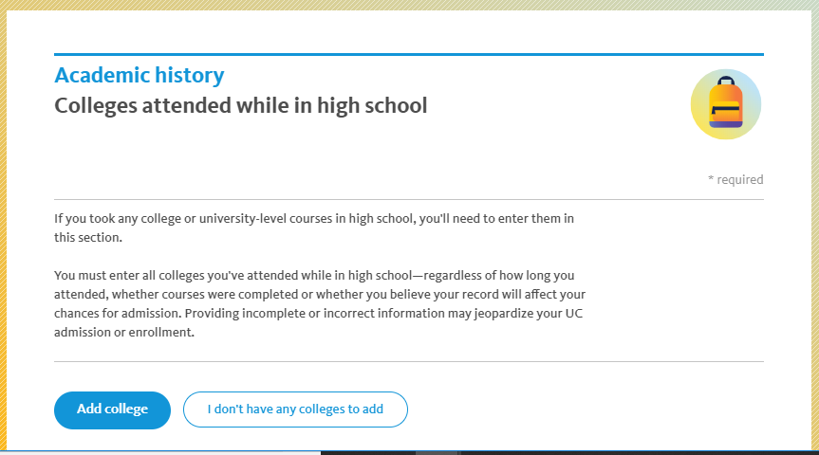
Adding DVC classes?

Slide 7
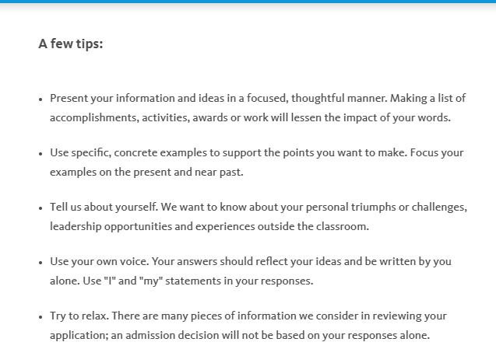

Slide 8
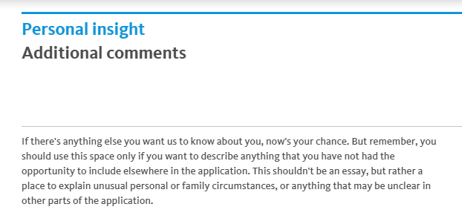
Did they miss something?

Slide 9
PIQ’s Tips
Picking your Topics:
Pick your topic, then match it to a question.
These questions are guides, but you control what the UCs learn about you.
Pick a different topic for each prompt: 4 prompts-4 topics.
Consider:
What questions haven’t the UC asked you on the application?
Was there something in your activities/awards list that couldn’t be described in 160 characters?
What does the UC not yet know about you?

Slide 10
Piq Tips
Do not be campus specific; each campus receives the same copy of your responses.
Keep it focused on YOU.
Do not write what you think the UCs want to hear.
Don’t stretch the truth, just be honest.
Be cautious of your timeline. Ask, “Is this relevant to me now?”
Each question has equal value, so answer what highlights your values best.

Slide 11
Question 1
Describe an example of your leadership experience in which you have positively influenced others, helped resolve disputes, or contributed to group efforts over time.
Brainstorm 3 circumstances, but ultimately choose 1 example to highlight your leadership.
You do not need a leadership title to be a leader.
Were you ever a mentor to others?
Ever had to take charge of a task? You are not limited to school, church, sports teams, etc.
What accomplishments have you had?

Slide 12
Question 2
Every person has a creative side, and it can be expressed in many ways: problem solving, original and innovative thinking, and artistically, to name a few. Describe how you express your creative side.
This is about creative thinking, intellectual vitality, and your curiosities.
If you are artistic, discuss your creativity, but keep the focus on why this is important to you and how it has influenced you now.
If you are not artistic, think about times you’ve had to think outside the box (mistakes, setbacks, challenges, losses, fears, etc.)
Ultimately, WHY DOES CREATIVITY HAVE VALUE IN THE WORLD AND TO YOU?

Slide 13
Question 3
What would you say is your greatest talent or skill? How have you developed and demonstrated that talent over time?
Brag about yourself, but do not feel like you have to say something impressive.
DEVELOPED: Warning: DO NOT story tell too much about the past. Who are you now?
DEMONSTRATED: SHOW, not just tell. Brainstorm 3 talents you LOVE about yourself, then see which one answers these questions
What are you proud of? SHOW WHY YOU LOVE IT.
It doesn’t have to mean you won an award for it.
How has it influenced you?
What have you learned from it?

Slide 14
Question 4
Describe how you have taken advantage of a significant educational opportunity or worked to overcome an educational barrier you have faced.
What have you learned from it?
2 parts to this question:
What happened (be specific)? Be careful not to story tell too much.
What did you learn and how will you use what you have learned in the future (personal qualities or practical developments along the way)?

Slide 15
Question 5
Describe the most significant challenge you have faced and the steps you have taken to overcome this challenge. How has this challenge affected your academic achievement?
Students forget to relate this back to who you are AS A STUDENT. This is NOT a venting session, so no complaining.

Slide 16
Question 6
Think about an academic subject that inspires you. Describe how you have furthered this interest inside and/or outside of the classroom.
Don’t write what you think the UCs want to hear. Describe HOW the subject has influenced or changed you.
Why does this subject matter also matter to the world? Think beyond yourself.
Describe a specific example showing how and why it’s your favorite.
Where do you lose track of time?
Maybe it’s a subject you would like to know more about and haven’t yet had the opportunity.

Slide 17
Question 7
What have you done to make your school or your community a better place?
Community: team, place, family, home, etc. You decide what community means to you.
What have been the most meaningful times? You could write a strong essay about volunteering, or giving back, but you have to be careful not to make it cliché.
Think of something unusual or unexpected that happened during one of these experience.
Focus on one scenario and be specific. Consider realizations, observations, lessons learned, etc.
How did it affect you? How do you intend to apply this in the future?
Do not repeat lessons learned from pervious Personal Insight Questions. Only offer new information.

Slide 18
Question 8
Beyond what has already been shared in your application, what do you believe makes you stand out as a strong candidate for admissions to the University of California?
This is super open ended. State something important about you that the other prompts have not addressed.
WARNING: Avoid “I’m a hard worker” or “I’m the funniest person ever…”
From your perspective, what will make you feel you belong on one of the UC campuses?
When looking at your life, what does a stranger need to understand in order to know you?
What is this unique thing about you important? How will this help you thrive at a UC?
How does this relate to your personal and academic goals?

